Slide 1
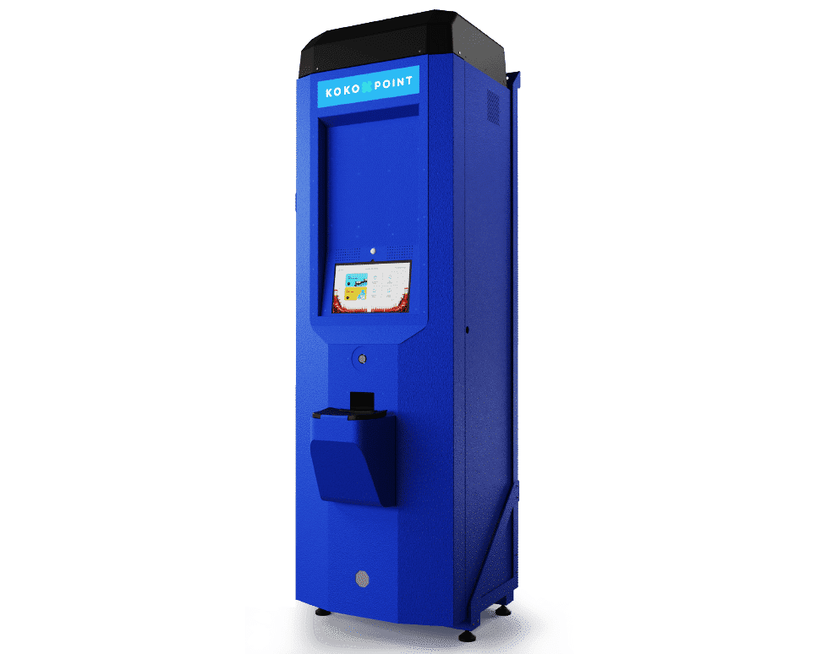
KOKOpoint dispenser parts and functions

Slide 2
Objectives
Objectives
The purpose of this presentation is to enable trainees understand:
List of parts contained in a fully assembled KOKOPoint(KP)
the basic functions of a KOKOpoint

Slide 3
Contents
Areas to be covered
Operations (high level overview)
KOKOpoint Hardware
Software

Slide 4
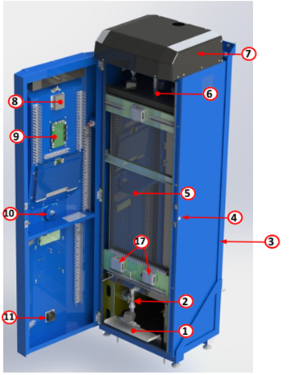
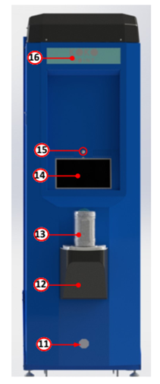
Standard nomenclature for KOKOpoint parts
1. Sump
2. Dispense column
3. L-Frame
4. Door lock
5. Tank
6. Refilling valves
7. Hood
8. Calibration unit
9. KP Controller
10. Canister Full Sensor
11. Ventilation fan
12. Canister dock
13. Canister
14. Screen
15. Motion sensor
16. KOKO sign
17. Emergency Switch
17
This nomenclature should be used consistently in all internal & external KOKO communications

Slide 5
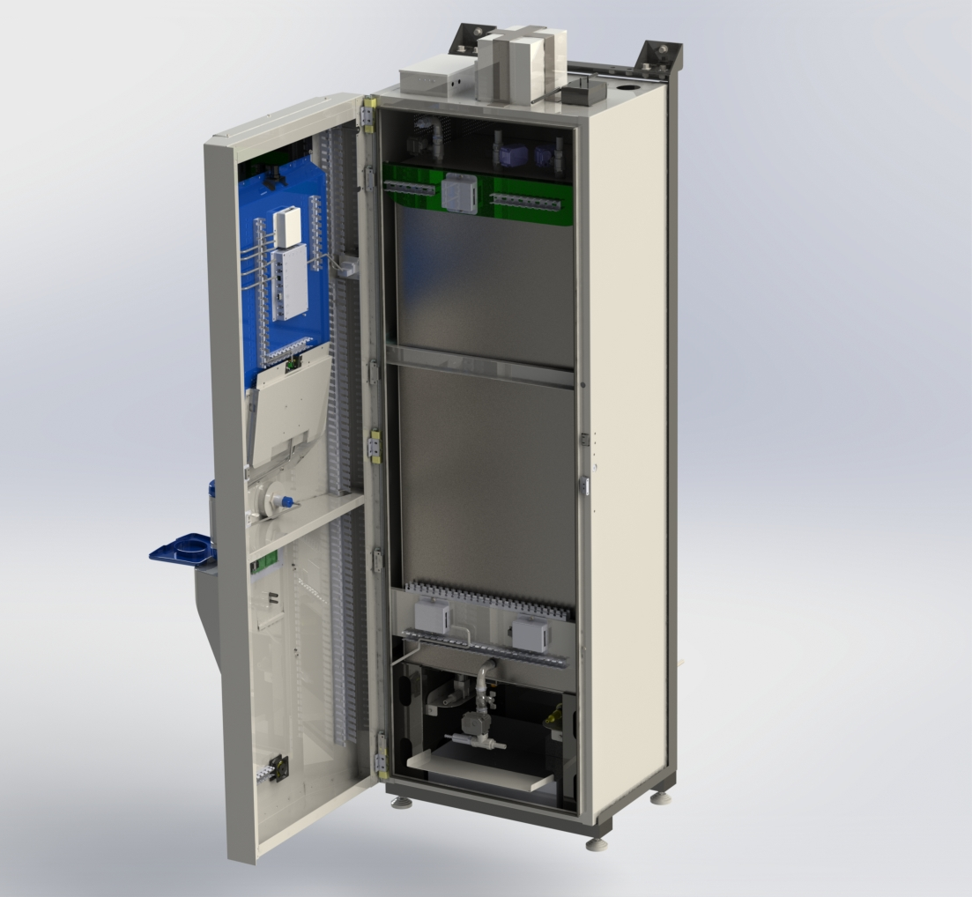
KOKOpoint overview
Battery
UPS
Modem
KOKOPoint controller
SS Tank
Tablet
Canister Dock
Dispense Column

Slide 6
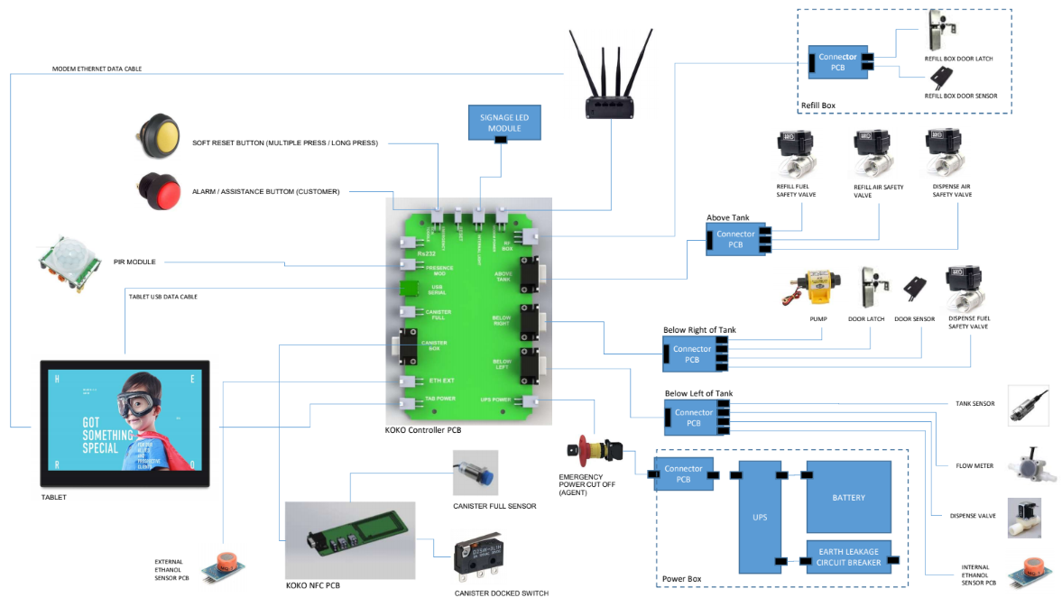

Slide 7
List of components
SENSORS & SWITCHES
Flowmeter(FLM)
NFC board
Tank level sensor(TPS)
Canister full sensor(CF)
Reed switch(KP door sensor & refill box door sensor)
PIR (motion sensor)
Dock limit switch(Canister dock switch)
Ethanol sensor
Temperature sensor
Reset switch
ACCESSIBILITY DEVICES
Tablet
Modem
Illumination module
POWER UNIT ACCESSORIES
UPS,
Battery
Emergency cut-off switch

Slide 8
List of components
PLUMBING PARTS & FITTINGS
Smart Valve
Pressure release valve(in the refill box)
½” manual ball valve
½” 3-piece union
½” nipple
½” tee joint
barbed connector(tail end-½”,¾”)
elbow(½”,¾”)
hose clip(9mm,11mm,28mm)
½”-to-¼” reducing bush
cam lock connector couplings
8mm silicone hose(dispense fuel line)
6mm silicone hose(dispense air line)
PCBs
KPC
Calibration module
Connector PCBs(Above tank,Below left and Below right,Refill box)
ACTUATORS
Motorised ball valves
Microelectric Pump
Diaphragm Valve (Solenoid)
Door lock & latch(for both the KP and refill box)
Fan

Slide 9
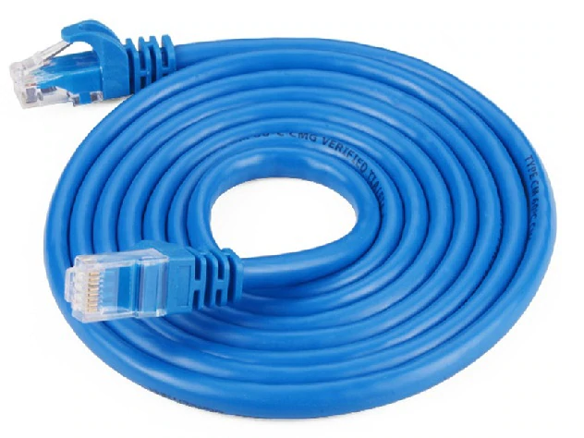
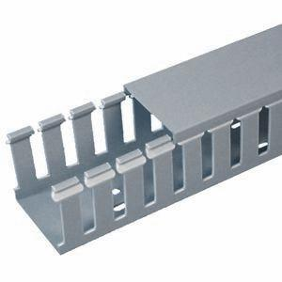
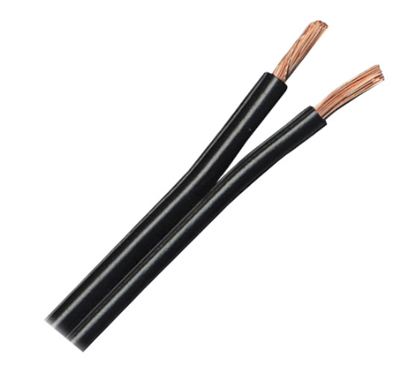
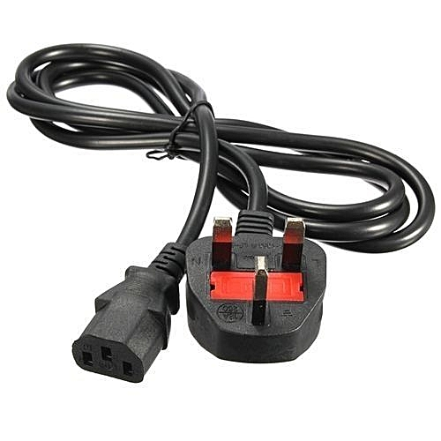
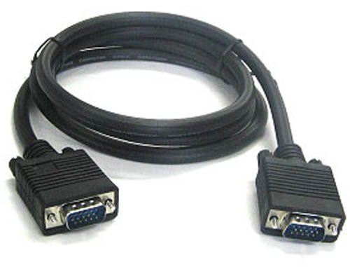
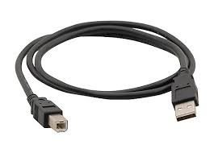
List of components
CAT 6 Ethernet cable
Cable tray
DC power cable
AC/Mains cable
D-connector cable
USB A-B cable

Slide 10
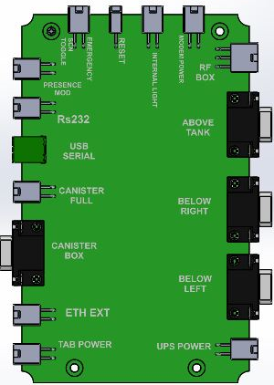
KPC(KOKOPoint Controller)
Custom built.
Heart of KP
The firmware is uploaded to the embedded arduino board(Mega 2560)

Slide 11
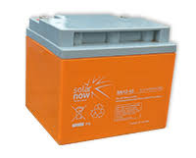
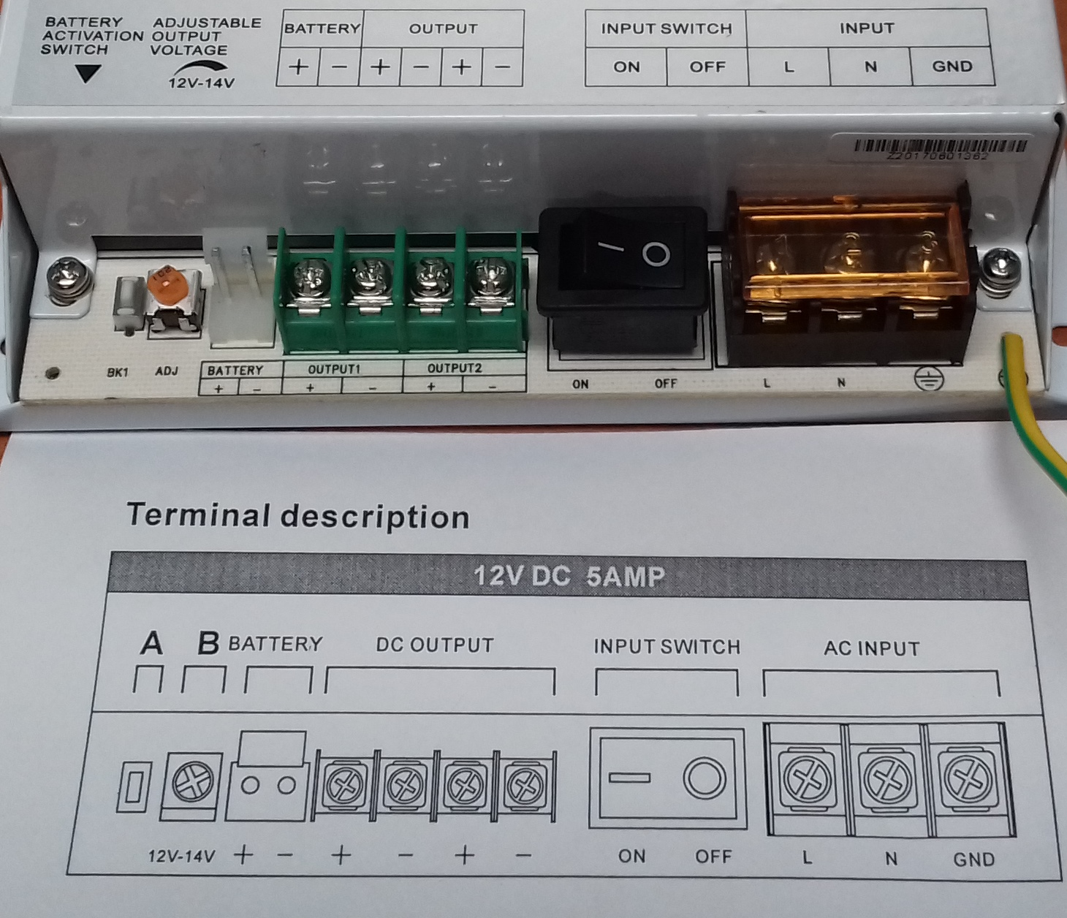
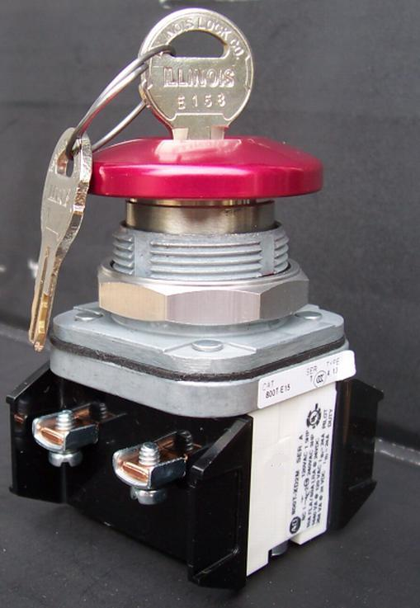
Contents
Power Unit
The power unit of the KP consists of UPS ,battery 12V 45Ah and an emergency cut-off switch just before the KPC input. .
cut-off switch
Battery

Slide 12
Contents
Power Unit
The power unit functions as below:
AC(240V)
DC(12V)
UPS
Charging
Back Up
12V Battery

Slide 13

Tablet
14” android device with 64GB internal storage.
An android application KOKO apk is installed to allow the customer to access his/her account,purchase stove s and purchase fuel.

Slide 14
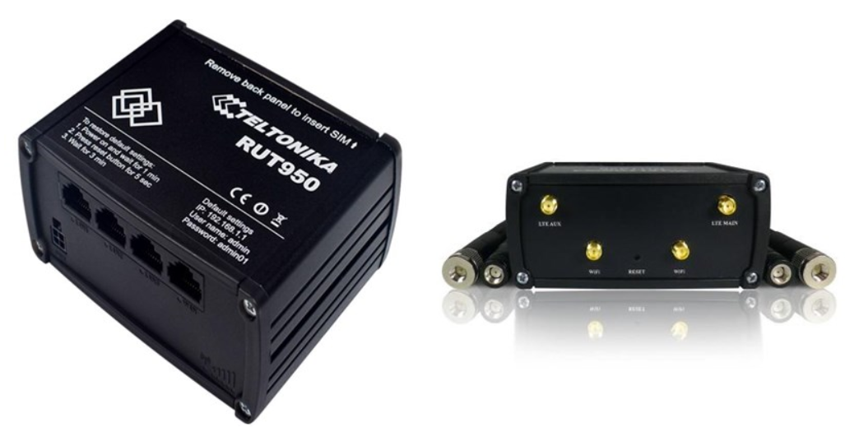
Modem
Teltonika modem - RUT950 (4G capable device)
The modem provided remote internet connectivity.
Service Providers: Safaricom (main service provider)
airtel Kenya (backup service provider).
It has two mobile antennae,a power cable and ethernet cable

Slide 15

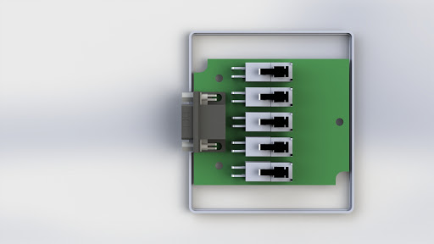
Connector PCB
Lead seal applied here
FLM
DV
TS
IE
TEMP
KOKOpoint connector PCB box for various components.
There are four PCB connectors above tank, below left, below right, and refill box
They connect the KPC to various components
Below Left Connector PCB

Slide 16
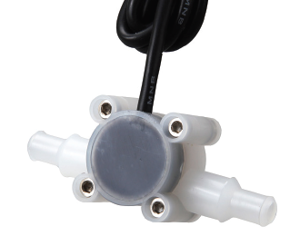
Flowmeter
The turbine flowmeter is the measuring unit of the KOKOpoint
Has a precision turbine that rotates freely generating pulses
Has a flow direction as demonstrated
A calibration exercise leads to selection of a K factor(FMK)

Slide 17
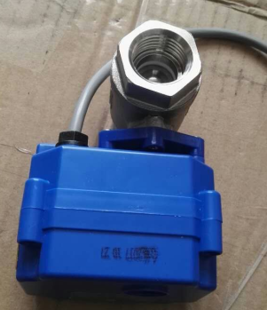
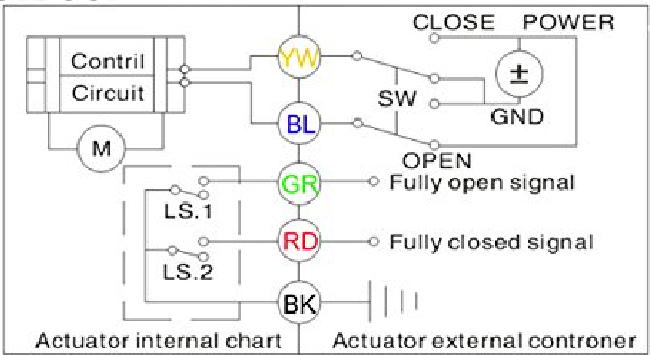
MBV
It is a motor driven actuator.
The valve opens to allow fuel flow or closes to end flow.
It uses two limit switches to indicate valve open/close status.

Slide 18
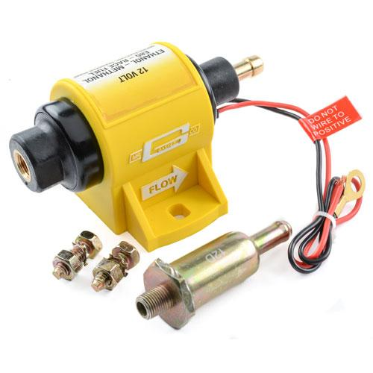
Contents
Microelectic Pump
This is an inline pump that provides a constant flow rate during dispensing
Include 100 micron inline filter
It is directional as shown by arrow
Pump Filter

Slide 19
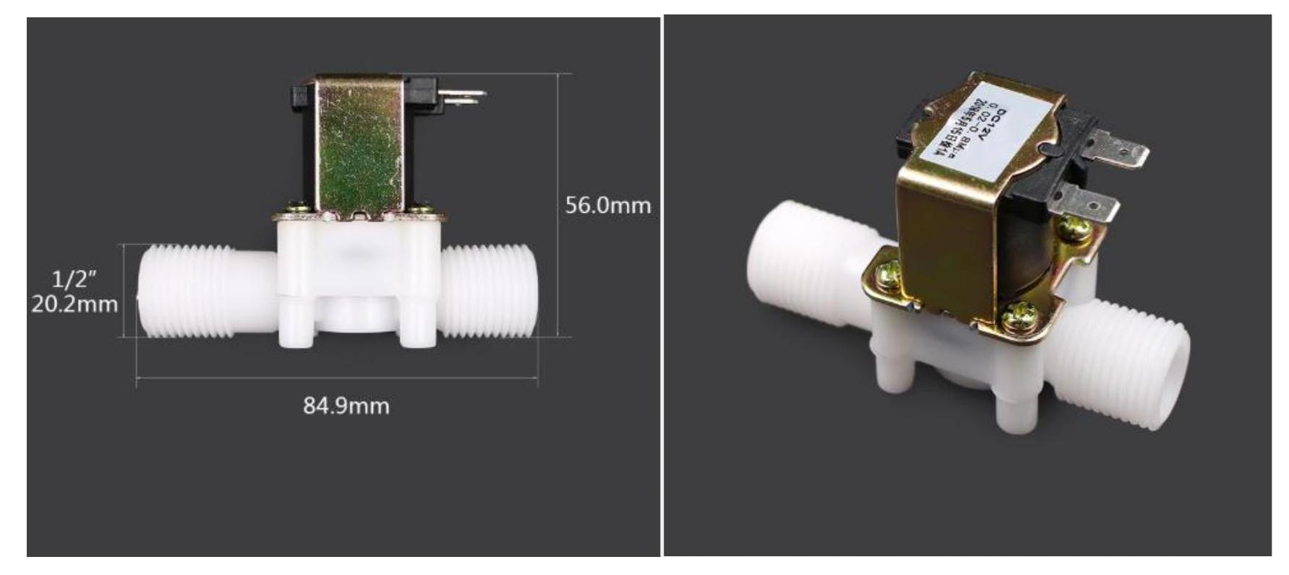
Contents
Diaphragm Valve, DV (Solenoid)
This a normally closed valve used for dispense precision during dispensing
It is one way valve(directional).

Slide 20
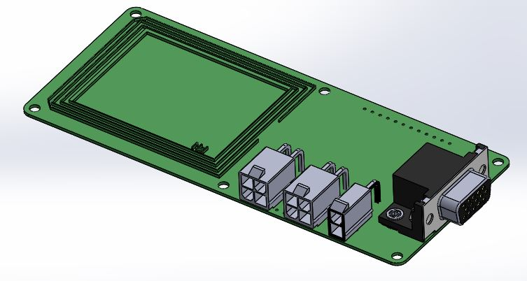
Contents
NFC PCB
NFC-Near field communication
NFC board reads the unique code on each canister for identification of customer

Slide 21
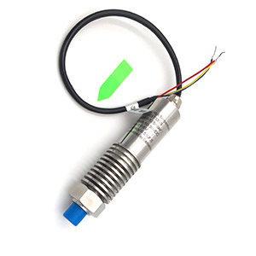
Tank Sensor
Level sensor indicates level of fuel in the tank
It is a 5V 130mbar analogue pressure sensor from Eastsensor

Slide 22
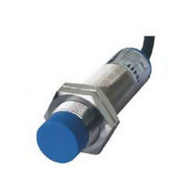
Canister Full Sensor
It is a capacitive sensor that prevents a canister from overfilling
Sensitive to ethanol in the canister at a range of 20mm
Has a sensitivity adjustment potentiometer

Slide 23
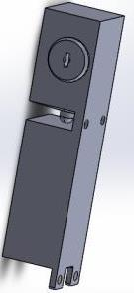
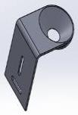
Door lock & latch
The electro-mechanical lock that enables both electronic access via the maintenance interface or mechanically using keys
Also present in the refill box
Lock
Latch

Slide 24
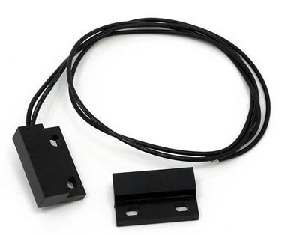
Door sensor & actuator
It is an electromagnetic switch that used to indicate when a KP door is opened or closed
Also present in the refill box

Slide 25
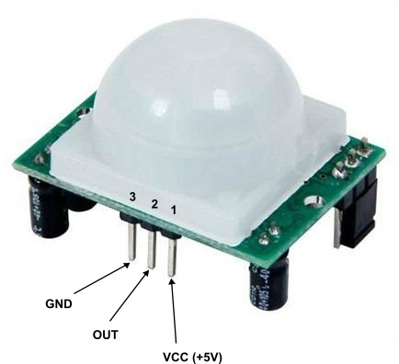
PIR Module
PIR- based motion detector
A passive infrared (PIR) sensor is an electronic sensor that measures infrared light radiating from objects in its field of view
The purpose in the KP is to sense movement of customers within a 2m radius and trigger various advert actions

Slide 26
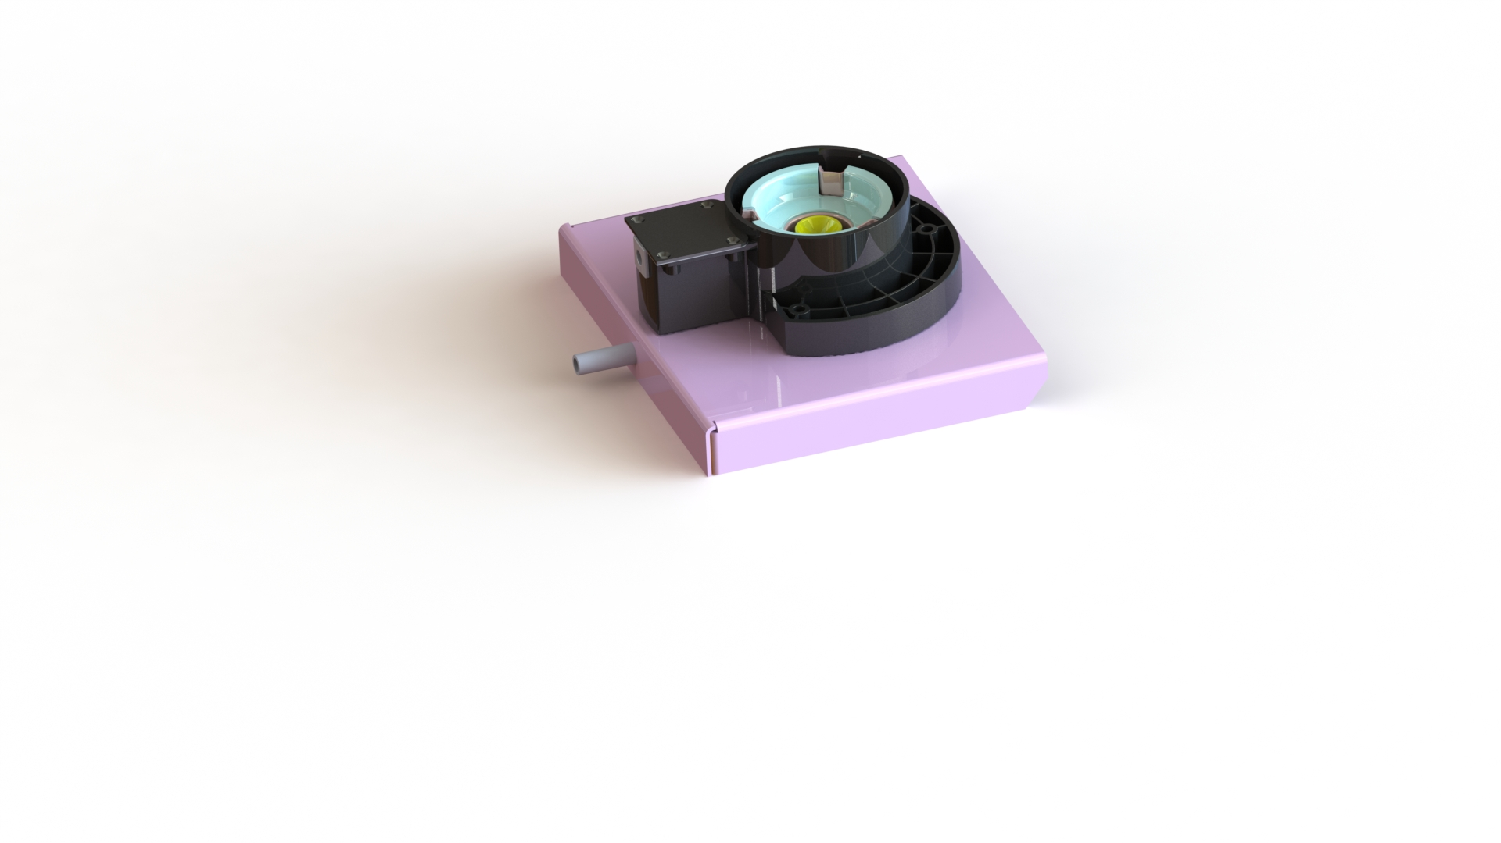
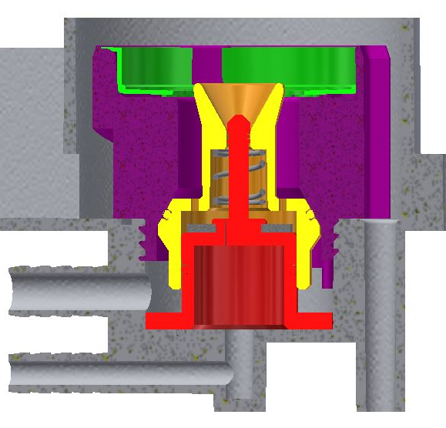
Smart Valve
This a custom made valve designed by KOKO
This is the canister docking point to enable a customer to purchase fuel
Contains a number of o-rings
Fuel line
Air line

Slide 27
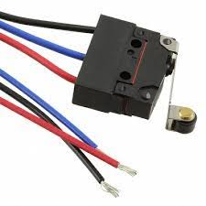
Dock Switch
The limit switch is the first check before a docked canister can be read and triggers the termination of a dispense when canister undocked

Slide 28
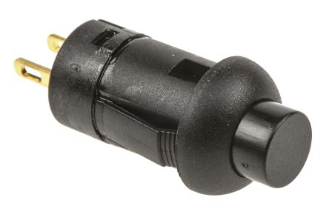
Reset Switch
The reset switch is used to powercycle the modem and tablet when pressed.
This is based on the KPC firmware

Slide 29
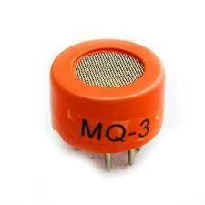
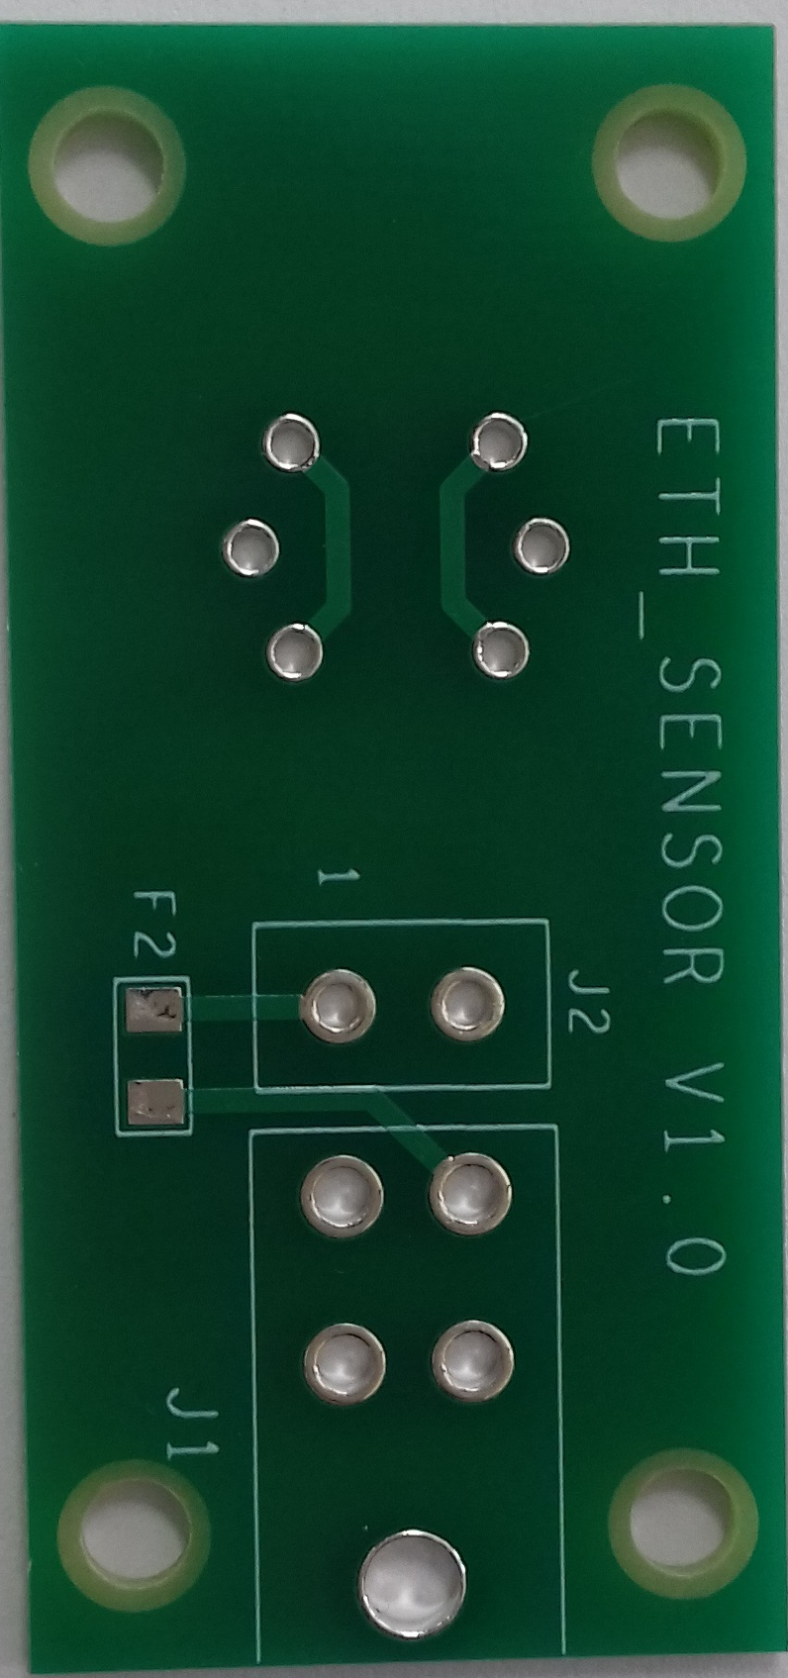
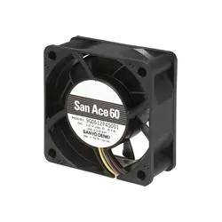
Ethanol Sensor & Fan
The ethanol sensor (MQ3) is used to detect ethanol vapour concentration in the KP.
This informs when a KP is leaking
The fan is constantly on to exhaust ethanol vapour around the dispense column and tray.
This is a safety measure to reduce risk of ignition.

Slide 30
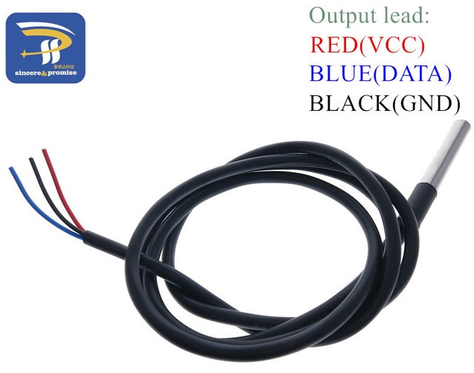
Tank temperature sensor
The 5V powered tank temperature sensor is stuck on the left bottom side of the tank
Function
Used to monitor fuel temperatures via the wall of the tank.

Slide 31
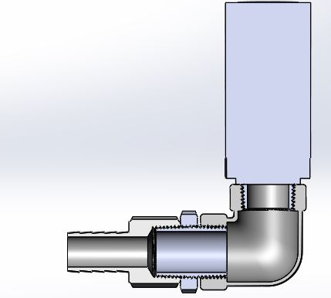
Pressure and Vacuum Release Valve, PVRV
Is a safety valve that controls tank ethanol vapour pressure per set safety threshold
Is fitted in the refill box

Slide 32
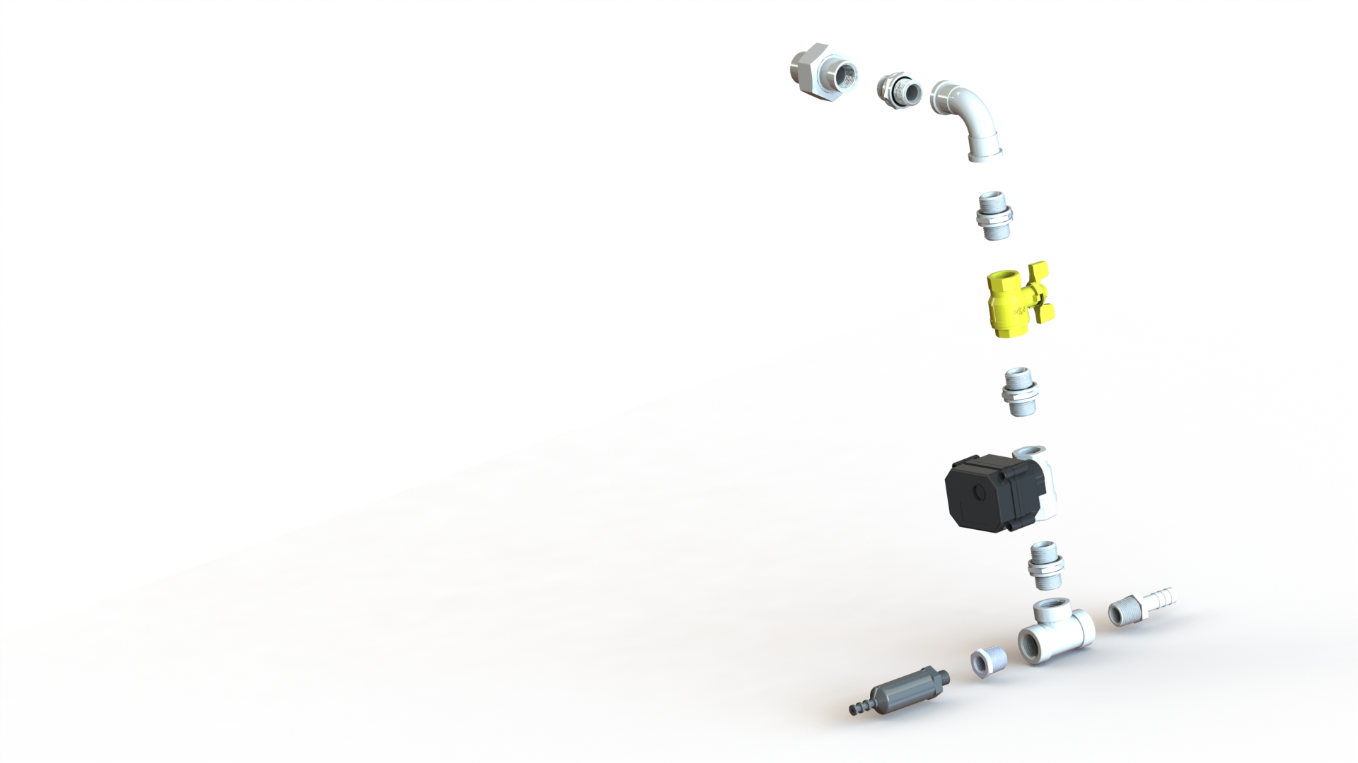
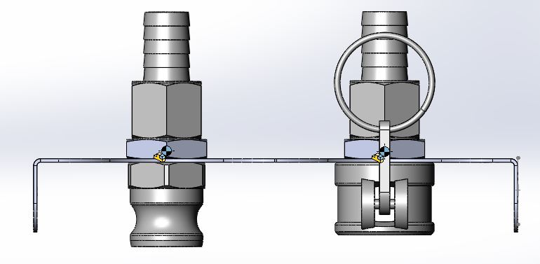
Plumbing Fittings
The KP has various SS mechanical fittings as shown below (right picture)
The main purpose is to join the dispense column to the tank
Manual ball valve is used to isolate the tank during maintenance of faulty components/fittings
The refill box consists of cam locks as shown (left picture) one for refill fuel and refill air
Union
Elbow
Nipple
Manual Ball Valve
Tail End
Tee Joint
Reducer

Slide 33
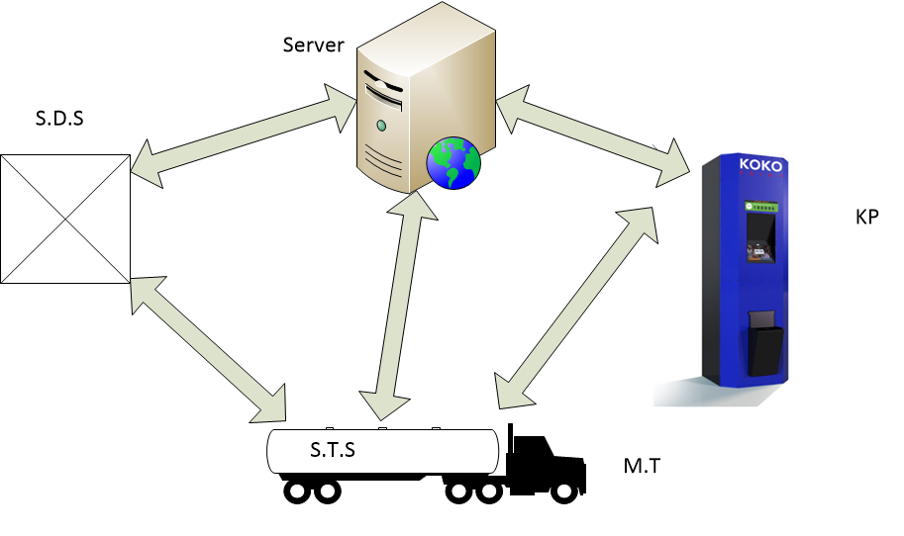
KP Communication Process
The KOKOpoint interacts with a number of KOKO platforms to aid in its operations as shown below
This is effected through the;
KPC firmware
KOKO Launcher and KOKO App

Slide 34
Dispense Process
When a customer docks a canister, NFC reader detects and reads the canister ID.
Through the tablet the customer logs into the system to buy fuel.
Communication with the server occurs via APIs when and the customer PIN requested.
Customer logs in and his/her account details are displayed.
Customer is able to buy fuel.
Customer logs out/exit and Undocks the canister.
A KOKO maintenance technician is also able to perform various maintenance tasks via the maintenance interface

